Slide 1
Face Detection & Recognition
Alan Zhang

Slide 2
Agenda
Face Detection & Recognition Work Flow
Overview of Face Detection & Recognition Algo
MTCNN
FaceNet

Slide 3
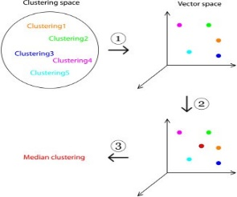
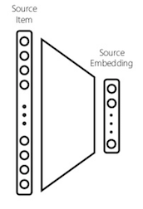
Face Detection & Recognition Workflow
Image Input
Face Detect
Face Landmark
Face Recognition
(KNN, SVM Classifiers)
Face Embedding
Face Normalization
Face Alignment
Notes:
Normalized rotation, translation, and scale representation of the face.
Facial recognition algorithms, including Eigenfaces, LBPs for face recognition, Fisherfaces, and deep learning/metric methods.
An embedding is the collective name for mapping input features to vectors. In a facial recognition system, these inputs are images containing a subject’s face, mapped to a numerical vector representation.
In a facial recognition context, this can vector distance be applied to calculate how similar two faces are. Additionally, these embeddings can be used as feature inputs into a classification, clustering, or regression task.

Slide 4
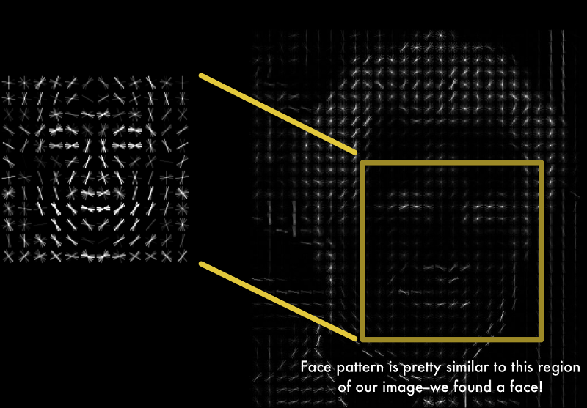
Algorithms for Face Detecting & Recognition
Face Normalization
Haar-cascade classifier to detect nose and eye
Landmark detector (dlib library) support 68 landmarks
OpenFace align face poses to be front-and-center-oriented
SDM (Supervised Descent Method), LBF (Local Binary Feature Regression), HPO (Head Pose Occlusion)
Face Detection
Haar-cascade classifier
Pros: Low computing power, supported by OpenCV directly
Cons: Fail to detect faces at pose angle
Histogram of Oriented Gradients (HOG)
Pros: Supported in OpenCV dlib, the strength is that it is NOT sensitive to the change of luminosity
Cons: Fail to detect faces at pose angle
DNN – MTCNN
Pros: High precision in faces detection with large angle pose, and mask, face tracking
Cons: More computing resource
Face Recognition
Eigenfaces: Based on PCA method, first compute eigenvalues, then compute eigenvectors respectively, then calculate the Euclidean distance between input face image and the eigenfaces.
Fisherfaces
Local Binary Patterns Histograms (LBPH)
DNN - FaceNet
Notes:
Classical Face Detection: https://blog.csdn.net/kuweicai/article/details/79330524
PCA: https://blog.csdn.net/kuweicai/article/details/79255270
Using a convolutional neural network is more efficient for performing a facial recognition than a statistical approach or searching for patterns.
Reference Codes:
https://gist.github.com/ageitgey/82d0ea0fdb56dc93cb9b716e7ceb364b
...
openface.AlignDlib(predictor_model)
...

Slide 5
Datasets for Face Detection & Recognition
WIDER Face
Home site: http://mmlab.ie.cuhk.edu.hk/projects/WIDERFace/
Train set, Test set, and Validation set.
Labeled Face Wild
Home site: http://vis-www.cs.umass.edu/lfw/
FDDB
Home site: http://vis-www.cs.umass.edu/fddb/
FDDB contains the annotations for 5171 faces in a set of 2845 images taken from the Faces in the Wild data set. More details can be found in the technical report below.
Notes:
Add sample numbers for these dataset respectively.

Slide 6
Purpose | Network Model or Libraries | Computing Req (Gflops) | Size of Parameters (MB) | Algo Type | Performance
Face Detect | OpenCV Haar Cascades/HOG Linear SVM Libs |  | 1~3.5 | Haar cascades or HOG + Linear SVM
Face Landmark | OpenCV Dlib |  | 2.6 | Histogram of Oriented Gradients + Linear SVM method
Face Alignment | OpenCV APIs |  | N/A | 2D rotation per calculated angle
Face Recognition | OpenCV FaceRecognizer APIs
Face Detect/Landmark/Alignment | MTCNN |  | Pnet: 0.55 Rnet: 0.809 Onet: 3.1 | DCNN
Face Recognition | OpenCV Eigenfaces, Fisherfaces and Local Binary Patterns Histograms (LBPH) |  |  | Eigenfaces, Fisherfaces and Local Binary Patterns Histograms (LBPH)
Face Recognition | Facenet |  | Network Top: 91 Parameter: 111 | DCNN
Notes:
Note: Under most cases, these algo are supported by multiple computing libs such as OpenCV and MatLab.
References:
https://www.pyimagesearch.com/2017/04/03/facial-landmarks-dlib-opencv-python/
https://www.pyimagesearch.com/2017/05/22/face-alignment-with-opencv-and-python/
https://www.pyimagesearch.com/pyimagesearch-gurus/
https://hackernoon.com/building-a-facial-recognition-pipeline-with-deep-learning-in-tensorflow-66e7645015b8
2 major technologies involving face alignment process:
To impose a (pre-defined) 3D model and then apply a transform to the input image such that the landmarks on the input face match the landmarks on the 3D model;
Other, more simplistic methods, rely only on the facial landmarks themselves (in particular, the eye regions) to obtain a normalized rotation, translation, and scale representation of the face.
Many facial recognition algorithms, including Eigenfaces, LBPs for face recognition, Fisherfaces, and deep learning/metric methods reply on the aligned faces before trying to identify the faces.

Slide 7
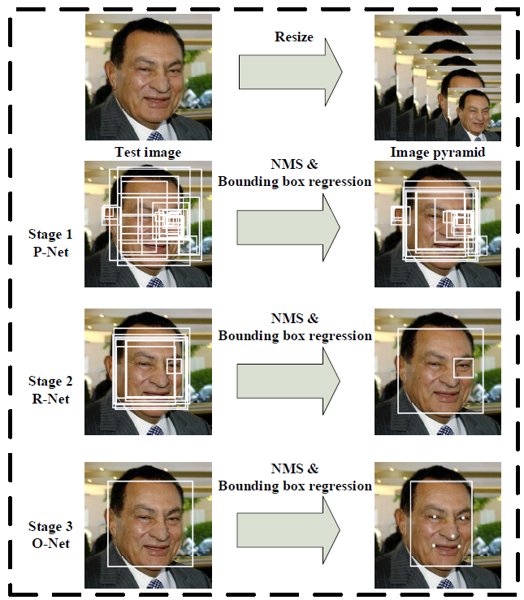
MTCNN Model Overview
照片会按照不同的缩放比例，缩放成不同大小的图片，形成图片的特征金字塔。PNet主要获得了人脸区域的候选窗口和边界框的回归向量。并用该边界框做回归，对候选窗口进行校准，然后通过非极大值抑制（NMS）来合并高度重叠的候选框。RNet将经过PNet的候选框在RNet网络中训练，然后利用边界框的回归值微调候选窗体，再利用NMS去除重叠窗体。ONet功能与RNet作用类似，只是在去除重叠候选窗口的同时，同时显示五个人脸关键点定位。
Notes:
http://www.infoq.com/cn/articles/how-to-achieve-face-recognition-using-mtcnn-and-facenet

Slide 8
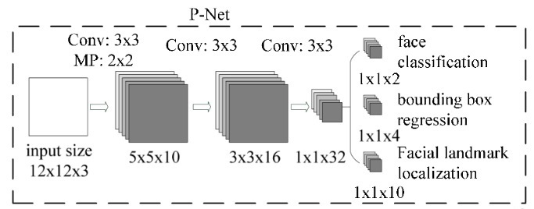
MTCNN Model - PNet
PNet的网络结构是一个全卷积的神经网络结构，该训练网络的输入是一个12*12大小的图片，训练数据通过10个3*3*3的卷积核，2*2的Max Pooling（stride=2）操作，生成10个5*5的特征图。接着通过16个3*3*10的卷积核，生成16个3*3的特征图。接着通过32个3*3*16的卷积核，生成32个1*1的特征图。最后针对32个1*1的特征图，可以通过2个1*1*32的卷积核，生成2个1*1的特征图用于分类；4个1*1*32的卷积核，生成4个1*1的特征图用于回归框判断；10个1*1*32的卷积核，生成10个1*1的特征图用于人脸轮廓点的判断。

Slide 9
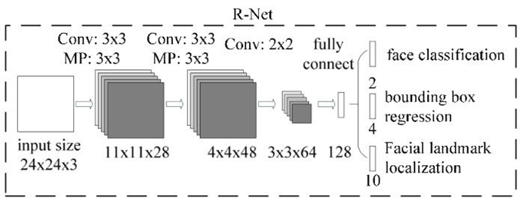
MTCNN Model - RNet
模型输入为24*24大小的图片，通过28个3*3*3的卷积核和3*3（stride=2）的max pooling后生成28个11*11的特征图；通过48个3*3*28的卷积核和3*3（stride=2）的max pooling后生成48个4*4的特征图；通过64个2*2*48的卷积核后，生成64个3*3的特征图；把3*3*64的特征图转换为128大小的全连接层；对回归框分类问题转换为大小为2的全连接层；对bounding box的位置回归问题，转换为大小为4的全连接层；对人脸轮廓关键点转换为大小为10的全连接层。

Slide 10
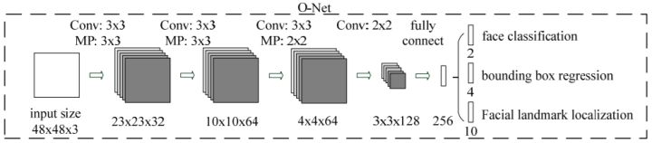
MTCNN Model - ONet
ONet是MTCNN中的最后一个网络，用于做网络的最后输出。模型输入是一个48*48*3大小的图片，通过32个3*3*3的卷积核和3*3（stride=2）的max pooling后转换为32个23*23的特征图；通过64个3*3*32的卷积核和3*3（stride=2）的max pooling后转换为64个10*10的特征图；通过64个3*3*64的卷积核和3*3（stride=2）的max pooling后转换为64个4*4的特征图；通过128个2*2*64的卷积核转换为128个3*3的特征图；通过全链接操作转换为256大小的全链接层；最好生成大小为2的回归框分类特征；大小为4的回归框位置的回归特征；大小为10的人脸轮廓位置回归特征。

Slide 11
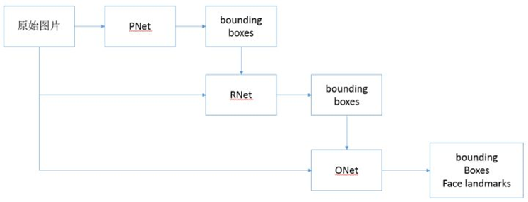
MTCNN – Inference Workflow
由原始图片和PNet生成预测的bounding boxes。输入原始图片和PNet生成的bounding box，通过RNet，生成校正后的bounding box。输入元素图片和RNet生成的bounding box，通过ONet，生成校正后的bounding box和人脸面部轮廓关键点。
首先读入要检测的图片：image = cv2.imread(imagepath)
加载训练好的模型参数，构建检测对象：detector = MtcnnDetector
执行推理操作：all_boxes,landmarks = detector.detect_face(image)
绘制目标框：cv2.rectangle(image, box,(0,0,255))

Slide 12
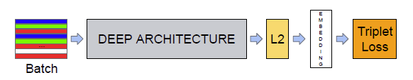
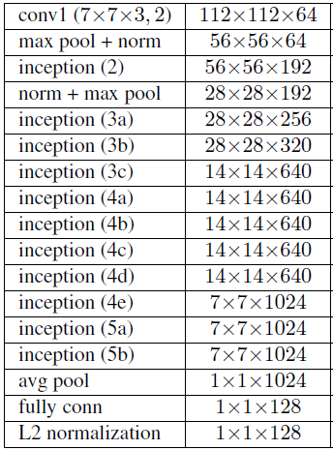
FaceNet - Overview
FaceNet的主要思想是把人脸图像映射到一个多维空间，通过空间距离表示人脸的相似度。
FaceNet中采用基于深度神经网络的图像映射方法和基于triplets（三联子）的loss函数训练神经网络，网络直接输出为128维度的向量空间。
FaceNet网络结构: Batch表示人脸的训练数据，接下来是深度卷积神经网络，然后采用L2归一化操作，得到人脸图像的特征表示，最后为三元组（Triplet Loss）的损失函数。三元组其实就是三个样例，如(anchor, pos, neg)，利用距离关系来判断。即在尽可能多的三元组中，使得anchor和pos正例的距离，小于anchor和neg负例的距离。
Notes:
References:
https://medium.com/@vinayakvarrier/building-a-real-time-face-recognition-system-using-pre-trained-facenet-model-f1a277a06947
https://hackernoon.com/building-a-facial-recognition-pipeline-with-deep-learning-in-tensorflow-66e7645015b8

Slide 13
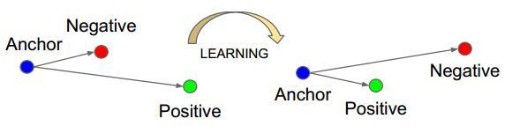
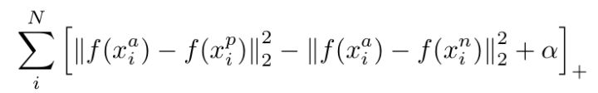
FaceNet - Training Flow
在mini-batch开始的时候，从训练数据集中抽样人脸照片。比如每一个batch抽样多少人，每个人抽样多少张图片，这样会得到要抽样的人脸照片。
计算这些抽样图片在网络模型中得到的embedding，这样通过计算图片的embedding之间的欧式距离得到三元组了。
根据得到的三元组，计算triplet-loss，进行模型优化，更新embedding。

Slide 14
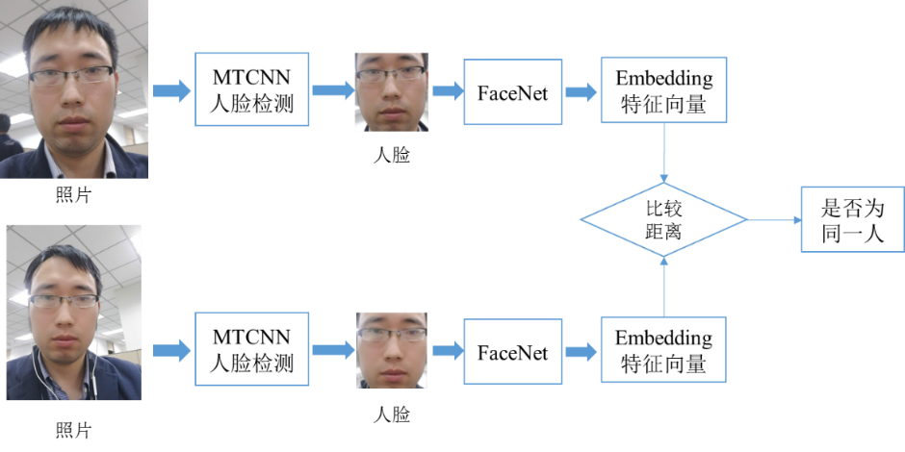
FaceNet – Inference Flow
通过MTCNN人脸检测模型，从照片中提取人脸图像。
把人脸图像输入到FaceNet，计算Embedding的特征向量。
比较特征向量间的欧式距离，判断是否为同一人，例如当特征距离小于1的时候认为是同一个人，特征距离大于1的时候认为是不同人。

Slide 15
Transfer MTCNN Model to OpenVINO
TBD

Slide 16
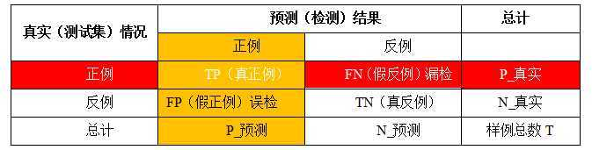
Performance
人臉檢測一般採用兩種曲線：P-R曲線和ROC曲線
P-R曲線是指的查准率（precision也稱準確率）和查全率（recall也成召回率）的曲線關係，查准率（P）在人臉檢測中指檢測到真實人臉數占檢測器檢測到人臉總數的百分比。查全率（R）在人臉檢測中指檢測到的真實人臉數占測試集中真實人臉總數的百分比。
ROC曲線則是真正例率和假正例率的曲線，真正例率（True Positive rate，TPR）為TP/P_TRUE等同於查全率，假正例率（False Positive rate，FPR）為FP/N_TRUE，前者評估的是漏檢水平，後者評估的是誤檢水平。

Slide 17
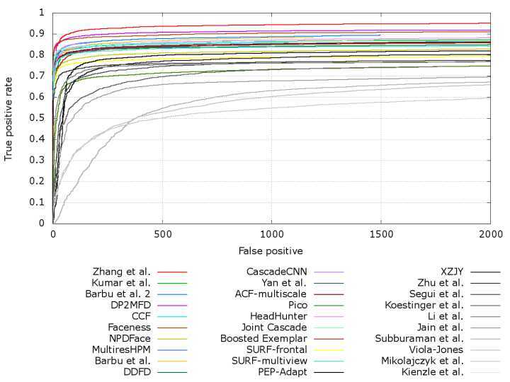

Slide 18
Backup

Slide 19
Terminologies
True positives (TP): These refer to the positive tuples that were correctly labeled by the classifier. Let TP be the number of true positives.
True negatives (TN): These are the negative tuples that were correctly labeled by the classifier. Let TN be the number of true negatives.
False positives (FP): These are the negative tuples that were incorrectly labeled as positive (e.g., tuples of class buys computer = no for which the classifier predicted buys computer= yes). Let FP be the number of false positives.
False negatives (FN): These are the positive tuples that were mislabeled as negative (e.g., tuples of class buys computer = yes for which the classifier predicted buys computer= no). Let FN be the number of false negatives.

Slide 20
History
人臉檢測的研究在過去二十年例取得了巨大進步，特別是Viola and Jones提出了開創性演算法，他們通過Haar-Like特徵和AdaBoost去訓練級聯分類器獲得實時效果很好的人臉檢測器，然而研究指出當人臉在非約束環境下，該演算法檢測效果極差。
人臉檢測演算法以往被分為基於知識的、基於特徵的、基於模板匹配的、基於外觀的四類方法。
人臉檢測所有演算法可以總分為兩類：①Based on rigid templates：代表有boosting+features和CNN ②Based on parts model：主要是DPM。
1981年的諾貝爾醫學獎獲得者David Hubel和TorstenWiesel發現了視覺系統的信息處理機制，也就是人的視覺系統的信息處理是分級的，高層的特徵是低層特徵的組合，從低層到高層的特徵表示越來越抽象，越來越能表現語義或者意圖抽象層面越高，存在的可能猜測就越少，就越利於分類。
在一幅影像信息中，各種複雜因素會以非線性的方式結合在一起。深度學習的關鍵優勢就是通過多層非線性映射將這些因素成功的區分，例如在深度模型的最後一個隱含層，不同的神經元代表了不同的因素。
最底層從原始pixel學習濾波器，刻畫局部邊緣和紋理特徵；緊接著中層濾波器通過低層各種邊緣濾波器的組合描述出不同類型的人臉器官；到最高層描述的是整個人臉的全局特徵。在最高的隱含層中，每個神經元代表一個屬性分類器，例如男女性別、人種、頭髮顏色等。每個神經元將圖像空間一分為二，N個神經元組合可以表達2N個局部區域，而淺層至少需要2N個。
深度學習方法有很多，如：自動編碼器、稀疏自動編碼器、受限波爾茲曼機（RBM）、深度信念網路（DBN）、卷積神經網路（CNN）、循環神經網路（RNN）、長短期記憶遞歸網路（LSTM）等。在圖像識別領域，主要用的是卷積神經網路（CNN）。

Slide 21
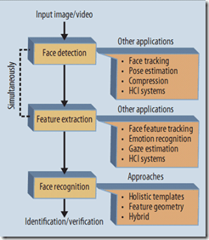
Software Operation Involving Face Detection & Recognition
Detection
* Filtering
* Nose and Eyes Landmark, Keypoints
Face Preprocess
Alignment
Crop faces at edge in image
Scale the cropped face image to post training size, ex. 96 x 96
Normalization
* Enhancement
* Filtering
* Registration
Video Frame Data Input
Matching
* Classifiers
* Density Estimation
* Distance Metrics
* Regressors
Extraction
* Clustering
* Normalization
* Subspace Learning
* Quantization
Representation
* Binary Pattern
* Keypoint Description
* Orientation Histogram
* Wavelets
Notes:
https://allenlu2007.wordpress.com/2016/05/05/%E4%BA%BA%E8%87%89%E5%81%B5%E6%B8%AC-face-detection-%E7%AE%97%E6%B3%95/

Slide 22
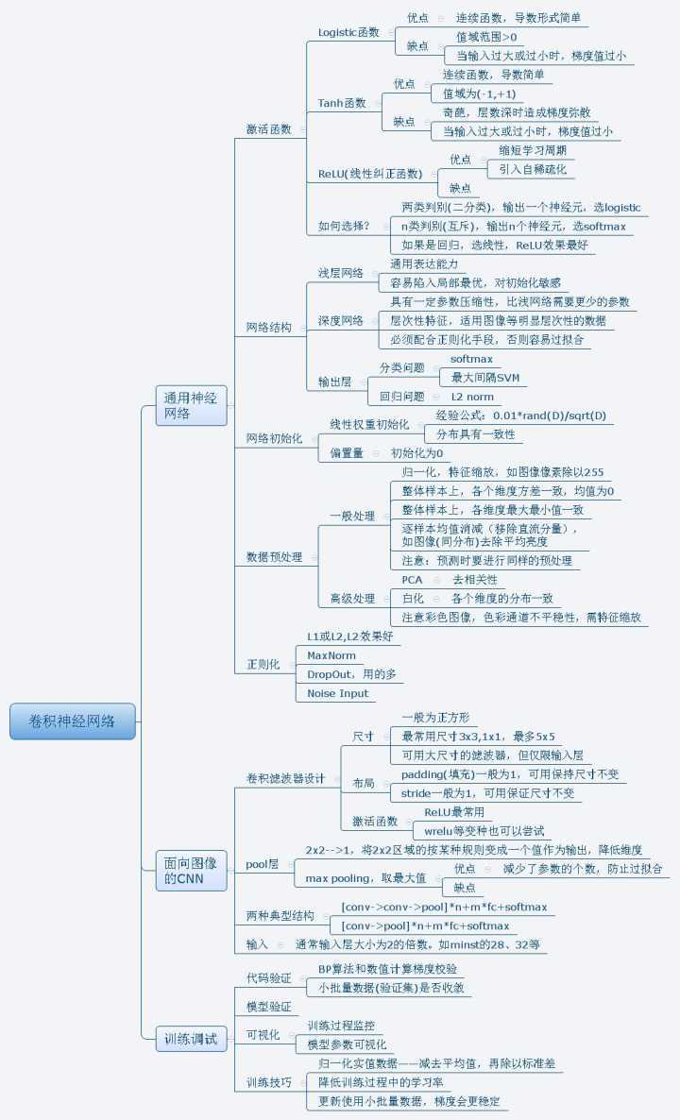

Slide 23
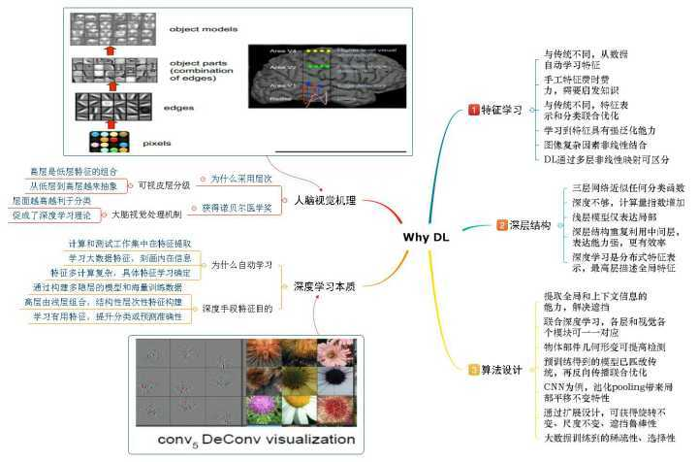

Slide 25
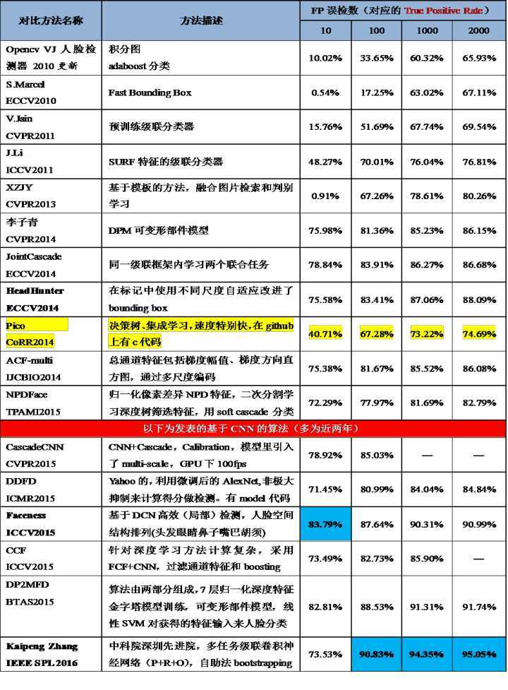
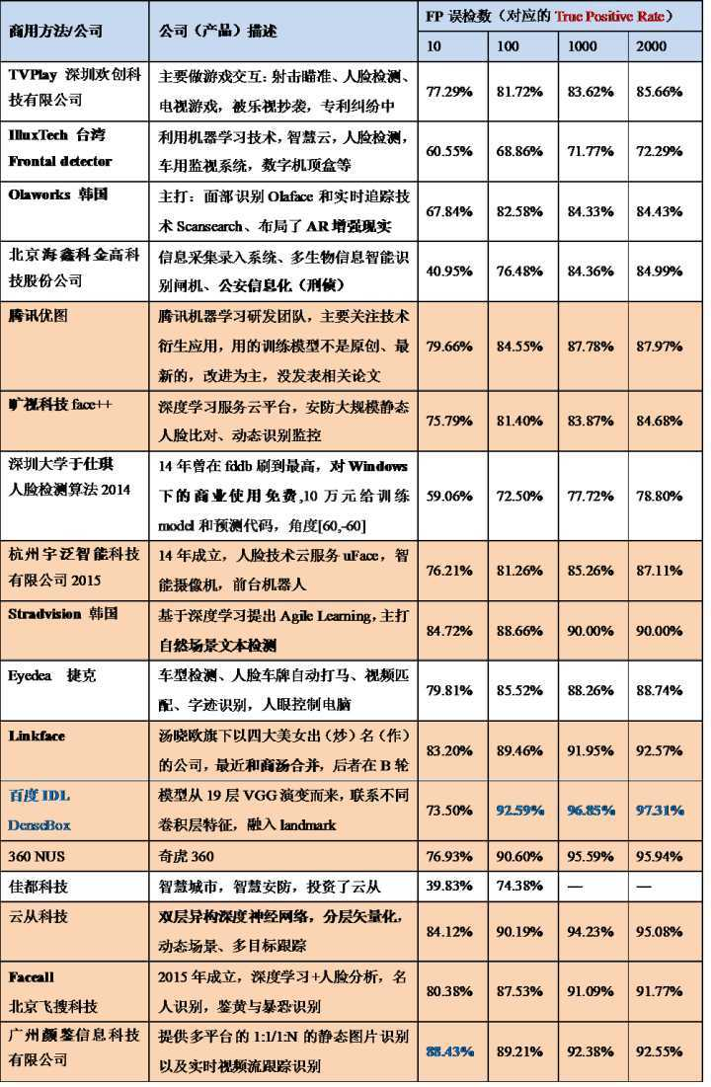

Slide 26
Conv2D in Tensorflow
Computes a 2-D convolution given 4-D input and filter tensors. Given an input tensor of shape [batch, in_height, in_width, in_channels] and a filter / kernel tensor of shape [filter_height, filter_width, in_channels, out_channels]

Slide 27
Reference
http://eyalarubas.com/face-detection-and-recognition.html
https://en.wikipedia.org/wiki/Eigenvalues_and_eigenvectors#Principal_components_analysis
https://medium.com/@ageitgey/machine-learning-is-fun-part-4-modern-face-recognition-with-deep-learning-c3cffc121d78
https://www.theseus.fi/bitstream/handle/10024/132808/Delbiaggio_Nicolas.pdf?sequence=1
Basic Tensorflow on CNN: https://beckernick.github.io/convolutions/

Slide 28

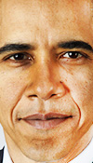
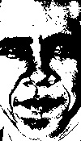
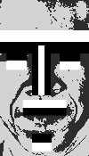
Principle of Face Detection
Templating Matching
- Demo: http://eyalarubas.com/face-detection-and-recognition.html
- https://en.wikipedia.org/wiki/Template_matching
- Feature-based approach
- Template-based approach
- Accuracy mean - Improvements can be made to the matching method by using more than one template (eigenspaces), these other templates can have different scales and rotations.
Notes:
PCA Introduction: https://blog.csdn.net/kuweicai/article/details/79255270

Slide 29
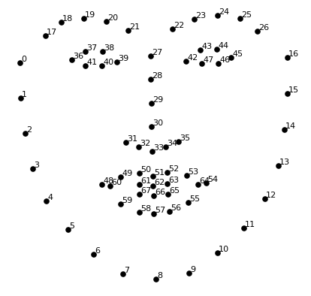
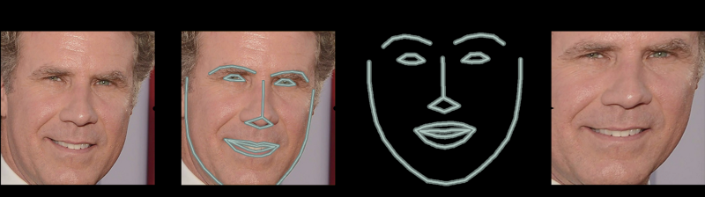
Face Landmark Estimation
68 specific points (called landmarks) that exist on every face
Train a machine learning algorithm to be able to find these 68 specific points on any face
Basic image transformations like rotation and scale that preserve parallel lines (called affine transformations), not 3D warp

Slide 30
Face Embedding
The training process works by looking at 3 face images at a time:
Load a training face image of a known person
Load another picture of the same known person
Load a picture of a totally different person
Then the algorithm looks at the measurements it is currently generating for each of those three images. It then tweaks the neural network slightly so that it makes sure the measurements it generates for #1 and #2 are slightly closer while making sure the measurements for #2 and #3 are slightly further apart.

Slide 31
Face Embedding cont'ed
OpenFace already did this and they published several trained networks which we can directly use. So all we need to do ourselves is run our face images through their pre-trained network to get the 128 measurements for each face.
Notes:
Reference:
https://medium.com/@ageitgey/machine-learning-is-fun-part-4-modern-face-recognition-with-deep-learning-c3cffc121d78
Sample Code:
https://gist.github.com/ageitgey/ddbae3b209b6344a458fa41a3cf75719

Slide 32
Principle of Face Recognition
General algo for Face Recognition
Eigenfaces, Fisherfaces and Local Binary Patterns Histograms (LBPH);
Eigenfaces and Fisherfaces find a mathematical description of the most dominant features of the training set as a whole, i.e. calculate the eigenfaces of a specific sample (ex. Barack Obama) dataset.
LBPH analyzes each face in the training set separately and independently.

Slide 33
Principle of Face Recognition
Principal Components Analysis (PCA)
By regarding image (gray'ed and filtered) as a row x col size vector, the train/validate sample dataset as vectors, calculate eigenvector of this vector space belong to a specific sample.

Slide 34
tfrecord Formt
tfrecord数据文件是一种将图像数据和标签统一存储的二进制文件，能更好的利用内存，在tensorflow中快速的复制，移动，读取，存储等。
tfrecord文件包含了tf.train.Example 协议缓冲区(protocol buffer，协议缓冲区包含了特征 Features)。你可以写一段代码获取你的数据， 将数据填入到Example协议缓冲区(protocol buffer)，将协议缓冲区序列化为一个字符串， 并且通过tf.python_io.TFRecordWriter class写入到TFRecords文件。

Slide 35
tfrecord Work Mechanism

